Slide 1
Module 5
PROJECT EXECUTION AND CLOUSRE

Slide 2
Contents
Project monitoring and control
-Project Closure-
Emerging trends in Software Engineering.

Slide 3
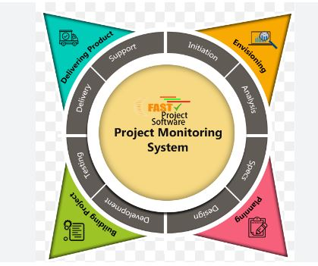
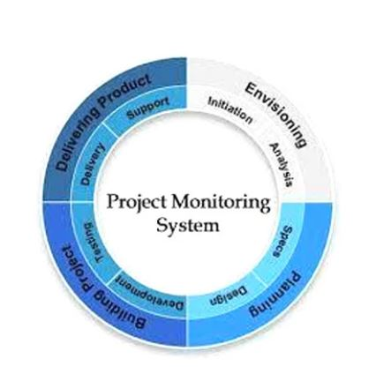
Monitoring
Monitoring in project management is a critical process that involves tracking, reviewing, and regulating the progress and performance of a project.
The goal is to ensure that the project stays on track, meets its objectives, and delivers its intended value. Here's an overview of key aspects of monitoring in project management.

Slide 4
Importance of Project Monitoring
The benefits of project monitoring are:
Ensure that the allotted budget is spent correctly and can be altered if needed.
To make sure that the selected task and deadlines are met.
The workforce can be allocated as per requirement to avoid risk factors
They offer feedback on effectiveness of policies and program to identify areas of improvement
To encourage accountability regarding the task assigned by the members of the team.
To shift the workforce to a particular task if it requires so.
To boost communication between the team members to increase quality and reduce time.

Slide 5
Purpose of Project monitoring
The purpose of project monitoring in project management is to ensure that the project is progressing as planned and that any deviations or issues are identified and addressed promptly. Here are the key purposes of project monitoring
.1. Ensuring Adherence to Plan
Schedule Compliance: Monitoring ensures that the project activities are being completed on time according to the project schedule.
Budget Control: It helps in keeping track of project expenses to ensure the project stays within the allocated budget.
2. Quality Assurance
Deliverable Quality: Ensuring that project deliverables meet the required quality standards and specifications.
Process Improvement: Identifying areas where project processes can be improved to enhance quality and efficiency.

Slide 6
3)Risk Management
Early Identification: Identifying potential risks early in the project lifecycle.
Proactive Mitigation: Implementing strategies to mitigate risks before they impact the project significantly.
4) Performance Measurement
Tracking Progress: Measuring progress against the project plan to ensure that project milestones and deliverables are being achieved.
Key Performance Indicators (KPIs): Using KPIs to evaluate the project's performance and identify areas for improvement.

Slide 7
5)Stakeholder Communication
Regular Updates: Providing stakeholders with regular updates on project status, progress, and issues.
Transparency: Ensuring transparency in project activities and decision-making processes, thereby building trust with stakeholders.
6)Change Management
Managing Changes: Handling requests for changes to the project scope, schedule, or budget effectively.
Impact Analysis: Assessing the impact of proposed changes on project objectives and deliverables to make informed decisions.

Slide 8
Key Activities
Performance Measurement: Identify and monitor critical performance indicators (KPIs) to compare the progress of a project against defined targets.
Progress Tracking: Update schedules and timelines for the project on a regular basis, and compare actual work with planned milestones to detect any delays or deviations.
Risk Identification and Assessment: Monitor actual risks, including their probability and consequences. Find new risks and assess the performance of current risk mitigation mechanisms.
Issue Identification and Resolution: Point out problems discovered in the process of project implementation, evaluate their scale and introduce corrective measures immediately.
Resource Monitoring: Track how resources are distributed and used, to ensure there is adequate equipment as well as support by the team members in meeting their objectives.

Slide 9
Quality Assurance: Monitor compliance with quality standards and processes, reporting deviations to take actions necessary for restoring the targeted level of quality.
Communication and Reporting: Disseminate project status updates, milestones reached and important findings to the stakeholders on a regular basis.
Change Control: Review and evaluate project scope, schedule or budget changes. Adopt structured change control processes to define, justify and approve changes.
Documentation Management: Make sure that project documentation is accurate, current and readily available for ready reference. This involves project plans, reports and other documents related to a particular project.

Slide 10
TOOLS AND TECHNIQUES
Tools
1)Project Management Software
Examples: Microsoft Project, Asana, Trello, Jira, Smartsheet.
Purpose: To plan, schedule, assign tasks, track progress, and collaborate with team members.
2)Dashboards
Examples: Tableau, Power BI.
Purpose: To provide real-time visualization of project metrics and KPIs, offering a quick overview of project health.

Slide 11
3)Gantt Charts
Purpose: To visualize the project schedule, showing task dependencies and timelines, and track progress against the plan.
4)Earned Value Management (EVM) Tools
Purpose: To integrate scope, schedule, and cost variables to assess project performance and progress.
5)Resource Management Tools
Examples: Resource Guru, Float.
Purpose: To manage and allocate project resources effectively, ensuring optimal utilization.

Slide 12
6)Risk Management Tools
Examples: Risk Register, Risk Matrix.
Purpose: To identify, assess, and manage project risks.
7)Quality Management Tools
Examples: Control charts, Pareto charts, Fishbone diagrams.
Purpose: To ensure that project deliverables meet the defined quality standards.

Slide 13
Techniques
1)Regular Status Meetings
Purpose: To review progress, discuss issues, and update stakeholders on the project status.
2)Progress Reporting
Purpose: To document and communicate the current status of the project to stakeholders through reports.
3)Performance Reviews
Purpose: To assess the performance of project activities against the project plan, including schedule and budget performance

Slide 14
4)Variance Analysis
Purpose: To compare planned performance with actual performance to identify and understand variances.
5)Trend Analysis
Purpose: To use historical data to predict future project performance and identify potential issues before they occur.
6)Critical Path Method (CPM)
Purpose: To identify the longest sequence of activities that must be completed on time for the entire project to be completed on schedule.

Slide 15
7)Schedule Performance Index (SPI) and Cost Performance Index (CPI)
Purpose: To measure the efficiency of time and cost management in the project.
8)Integrated Change Control
Purpose: To review and approve changes to the project scope, schedule, and budget in a structured manner.

Slide 16
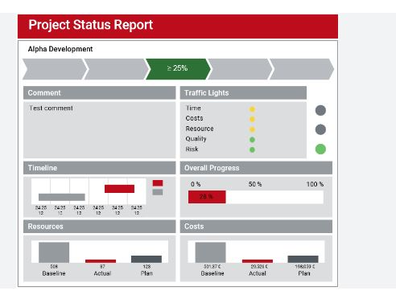
Project status report
A project status report is a document that describes the progress of a project within a specific time period and compares it against the project plan.
Project managers use status reports to keep stakeholders informed of progress and monitor costs, risks, time and work.
Project status reports allow project managers and stakeholders to visualize project data through charts and graphs.
The status report for a project generally includes the following:
The work that’s been completed
The plan for what will follow
The summary of the project budget and schedule
A list of action items
Any issues and risks, and what’s being done about them

Slide 17
Need for project status reports:
1)Communication and Transparency
Stakeholder Communication: Regular status reports keep stakeholders informed about the project's progress, helping to manage their expectations and ensuring they are aware of any changes or issues.
Team Communication: These reports ensure that team members are on the same page, promoting consistency and coordination within the project team.
2. Progress Tracking
Milestones and Deliverables: Status reports help track the completion of milestones and deliverables, providing a clear view of what has been achieved and what remains to be done.
3. Risk Management
Identifying Risks: Regular reporting allows for the early identification of potential risks and issues that could impact the project.
Mitigation Strategies: By highlighting risks early, status reports enable the development and implementation of mitigation strategies to address these risks before they escalate.
4. Resource Management
Resource Allocation: Status reports help in assessing whether the current allocation of resources is adequate and effective.
Adjustments and Optimization: They allow for timely adjustments in resource allocation to optimize productivity and address any resource-related issues.

Slide 18
5)Accountability and Responsibility
Tracking Accountability: By documenting progress and issues, status reports hold team members accountable for their tasks and responsibilities.
Performance Evaluation: They provide a basis for evaluating the performance of team members and the project as a whole.
6) Documentation and Record-Keeping
Project Documentation: Status reports serve as an official record of the project's progress and decisions made during its lifecycle.
Historical Reference: They provide valuable information for future projects, allowing teams to learn from past experiences and improve their processes.
7)Enhancing Stakeholder Confidence
Building Trust: Regular and transparent updates build trust between the project team and stakeholders.
Demonstrating Control: They demonstrate that the project is being managed effectively and is under control, increasing stakeholder confidence in the project's success.

Slide 19
Project metrics
Project metrics are quantitative measures used to assess various aspects of a project, helping in its management and evaluation. Here are two primary purposes of project metrics:
1. Performance Measurement and Improvement
Project metrics provide a means to quantitatively assess the performance of a project. By measuring specific aspects of the project, such as time, cost, scope, quality, and efficiency, these metrics help project managers understand how well the project is progressing relative to its goals and objectives.
Tracking Progress: Metrics such as schedule variance (SV), cost variance (CV), and earned value (EV) help track whether the project is on schedule and within budget. For instance, SV provides insight into whether the project is ahead or behind schedule, while CV indicates if the project is over or under budget.
Quality Assessment: Metrics like defect density, test coverage, and customer satisfaction scores provide insights into the quality of the deliverables. These metrics help ensure that the project meets the required standards and expectations.
Process Improvement: By analyzing metrics, project managers can identify areas where processes can be improved. For example, if cycle time is consistently higher than expected, the team might need to streamline workflows or address bottlenecks.

Slide 20
2)Decision Making and Risk Management
Project metrics play a crucial role in informed decision-making and effective risk management. They provide the data and insights necessary to make strategic decisions and mitigate potential risks.
Informed Decision Making: Metrics such as return on investment (ROI), net present value (NPV), and benefit-cost ratio (BCR) help in making financial decisions related to project investments. These metrics ensure that resources are allocated efficiently and that the project delivers the expected value.
Risk Identification and Mitigation: Risk-related metrics, like risk exposure and risk mitigation index, help in identifying potential risks early and evaluating the effectiveness of risk management strategies. By continuously monitoring these metrics, project managers can proactively address risks before they become critical issues.
Resource Allocation: Metrics like resource utilization rates and productivity rates help in optimizing resource allocation. Understanding these metrics ensures that resources are used effectively and are not over- or under-utilized.

Slide 21
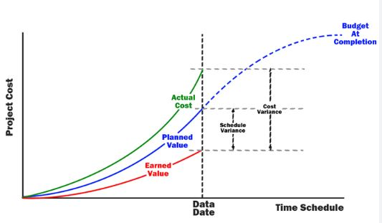
Earned Value Analysis (EVA)
Earned Value Analysis (EVA) is also called “Budget cost of work performed”. It is considered a refinement of the cost-monitoring technique. This analysis was first carried out USA’s Department of Defense (DOD). In this analysis, a “value” is assigned to each track or work package based on the expenditure forecast. The value assigned is known as the “planned value (PV)”. The work that has not yet begun is given a value known as the “earned value of zero”. The total value credited to a project is called “earned value(EV)”, which is also represented as “money value”.
Methods For Earned Value Analysis
1)0/100 Technique: The technique where a task is assigned a value of zero until such time that is completed when it is given a value of 100% of the budgeted value.
2)50/50 Technique: The technique in which a task is assigned a 50% value as soon as it is started and then given a value.
3)Technique: The technique where a task is assigned 75% on starting and 25% on completion.

Slide 22
4)Milestone Technique: The technique where a task is given a value based on the achievement of milestones that have been assigned values as part of the original budget plan.
5)Percentage Complete: In some cases, there may be a way of objectively measuring the amount of work completed.
Stages in Earned Value Analysis
Creating the baseline budget: This is the first stage in setting up EVA. This budget is based on the project plan. It predicts the earned value through time. Normally, it is measured in person hours or workdays, for example: in a software development project.
Monitoring Earned Value: The second stage is monitoring the earned value as the project progresses. This is achieved by monitoring the completion of each task. Actual cost(AC) is the actual cost of each task and it can be analyzed and collected.
Schedule Variance(SV): This is the third stage which is measured in cost as EV-PV which is the deviation between planned work and completed work. Example: Consider these values, PV =40000 EV=35000 SV=35000-40000 = -5000Here the calculated SV value is negative and hence we conclude that the project is behind the original schedule.

Slide 23
Time variance(TV): The difference between the current time and the time when the achievement of the earned value was planned to occur.
Cost Variance(CV): This value is the difference between the actual cost and the earned value. Using this value we can estimate the accuracy of the original cost scheduled for the project. If the CV values are found to be negative, we conclude the project is over cost.

Slide 24
3 Basic Parameters of EVA.
1. Planned Value (PV)
Definition: PV, also known as Budgeted Cost of Work Scheduled (BCWS), is the authorized budget assigned to scheduled work to be accomplished during a specific time period. It represents the cost of work that should have been performed by a certain date according to the project plan.
Formula: PV=Sum of the budgeted cost for scheduled work up to a specific datePV = \text{Sum of the budgeted cost for scheduled work up to a specific date}PV=Sum of the budgeted cost for scheduled work up to a specific date
Example: Consider a project with a total budget of $100,000, scheduled to be completed in 10 months. If by the end of the 3rd month, the project was scheduled to have $30,000 worth of work completed,
then: PVmonth 3=$30,000PV_{\text{month 3}} = \$30,000PVmonth 3​=$30,000

Slide 25
2. Earned Value (EV)
Definition: EV, also known as Budgeted Cost of Work Performed (BCWP), is the measure of work actually performed expressed in terms of the budget authorized for that work. It represents the value of work actually completed by a specific date, regardless of the actual cost incurred.
Formula: EV=Sum of the budgeted cost for actual completed work up to a specific dateEV = \text{Sum of the budgeted cost for actual completed work up to a specific date}EV=Sum of the budgeted cost for actual completed work up to a specific date
Example: Using the same project, if by the end of the 3rd month, $25,000 worth of work has actually been completed (as per the project's budgeted cost for that work), then: EVmonth 3=$25,000EV_{\text{month 3}} = \$25,000EVmonth 3​=$25,000
3. Actual Cost (AC)
Definition: AC, also known as Actual Cost of Work Performed (ACWP), is the total cost actually incurred and recorded in accomplishing the work performed by a specific date. It includes all costs (direct and indirect) spent on the project.
Formula: AC=Sum of the actual costs for completed work up to a specific dateAC = \text{Sum of the actual costs for completed work up to a specific date}AC=Sum of the actual costs for completed work up to a specific date
Example: For the same project, if by the end of the 3rd month, the actual expenditure on the work completed is $28,000, then: ACmonth 3=$28,000AC_{\text{month 3}} = \$28,000ACmonth 3​=$28,000

Slide 26
10. Variance at Completion (VAC)
VAC predicts the budget variance at the end of the project.
VAC=BAC−EACVAC = BAC - EACVAC=BAC−EAC
11. To-Complete Performance Index (TCPI)
TCPI indicates the cost performance needed to achieve a specific management goal, such as BAC or EAC.
TCPIBAC=BAC−EVBAC−ACTCPI_{BAC} = \frac{BAC - EV}{BAC - AC}TCPIBAC​=BAC−ACBAC−EV​
TCPIEAC=BAC−EVEAC−ACTCPI_{EAC} = \frac{BAC - EV}{EAC - AC}TCPIEAC​=EAC−ACBAC−EV​
TCPI > 1: Greater efficiency is required.
TCPI < 1: Less efficiency is required.

Slide 27
Different Methods for Earned Value Analysis.
1. Planned Value (PV)
Also known as Budgeted Cost of Work Scheduled (BCWS), PV is the estimated value of the work planned to be completed by a specific date. It represents the budget authorized for the scheduled work.
PV=Sum of the budgeted cost for scheduled workPV = \text{Sum of the budgeted cost for scheduled work}PV=Sum of the budgeted cost for scheduled work
2. Earned Value (EV)
Also known as Budgeted Cost of Work Performed (BCWP), EV is the value of work actually completed by a specific date, measured against the planned budget.
EV=Sum of the budgeted cost for completed workEV = \text{Sum of the budgeted cost for completed work}EV=Sum of the budgeted cost for completed work
3. Actual Cost (AC)
Also known as Actual Cost of Work Performed (ACWP), AC is the total cost actually incurred and recorded in accomplishing the work performed by a specific date.
AC=Sum of the actual costs for completed workAC = \text{Sum of the actual costs for completed work}AC=Sum of the actual costs for completed work

Slide 28
4. Schedule Variance (SV)
SV indicates how much ahead or behind schedule the project is. It is the difference between the Earned Value and the Planned Value.
SV=EV−PVSV = EV - PVSV=EV−PV
SV > 0: Project is ahead of schedule.
SV < 0: Project is behind schedule.
5. Cost Variance (CV)
CV indicates how much under or over budget the project is. It is the difference between the Earned Value and the Actual Cost.
CV=EV−ACCV = EV - ACCV=EV−AC
CV > 0: Project is under budget.
CV < 0: Project is over budget.
6. Schedule Performance Index (SPI)
SPI is a measure of schedule efficiency. It is the ratio of Earned Value to Planned Value.
SPI=EVPVSPI = \frac{EV}{PV}SPI=PVEV​
SPI > 1: Project is ahead of schedule.
SPI < 1: Project is behind schedule.

Slide 29
7. Cost Performance Index (CPI)
CPI is a measure of cost efficiency. It is the ratio of Earned Value to Actual Cost.
CPI=EVACCPI = \frac{EV}{AC}CPI=ACEV​
CPI > 1: Project is under budget.
CPI < 1: Project is over budget.
8. Estimate at Completion (EAC)
EAC forecasts the total cost of the project at completion, based on current performance.
EAC=BAC÷CPIEAC = BAC \div CPIEAC=BAC÷CPI
or
EAC=AC+(BAC - EV)EAC = AC + \text{(BAC - EV)}EAC=AC+(BAC - EV)
where BAC is the Budget at Completion.
9. Estimate to Complete (ETC)
ETC forecasts the remaining cost needed to complete the project.
ETC=EAC−ACETC = EAC - ACETC=EAC−AC
10. Variance at Completion (VAC)
VAC predicts the budget variance at the end of the project.
VAC=BAC−EACVAC = BAC - EACVAC=BAC−EAC

Slide 30
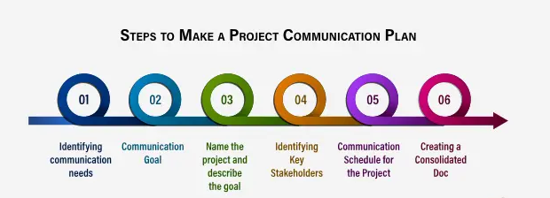
Project Communication Plan
A project communication plan is an agreement between collaborators and stakeholders that outlines what, when, and how information will be shared at key intervals. Information like status updates, task-related questions, and meeting details should all be included in this written guide. The goal is to define and streamline team communications as much as possible.

Slide 31
Steps to Write a Project Communication Plan
Step 1: Identify Stakeholders
Objective: Determine who needs to be informed about the project and who will be providing information.
Actions:
List all stakeholders, including project team members, sponsors, clients, and any other relevant parties.
Categorize stakeholders based on their roles and influence on the project.
Output: Stakeholder list and categorization.
Step 2: Define Communication Objectives
Objective: Clarify the purpose of the communication plan and what it aims to achieve.
Actions:
Determine the main goals of the project communication (e.g., keeping stakeholders informed, ensuring alignment, facilitating decision-making).
Establish clear, measurable objectives for communication.
Output: List of communication objectives.

Slide 32
Step 3: Determine Communication Methods and Channels
Objective: Select the most effective ways to communicate with stakeholders.
Actions:
Choose appropriate communication methods (e.g., meetings, emails, reports, dashboards).
Select channels that best suit each stakeholder group (e.g., face-to-face meetings for high-level stakeholders, email updates for team members).
Output: List of communication methods and channels.
Step 4: Establish Communication Frequency and Timing
Objective: Decide how often communications will occur and align them with project milestones.
Actions:
Set a communication schedule (e.g., weekly status meetings, monthly progress reports).
Align communication timing with project phases and key milestones.
Output: Communication schedule and timing.

Slide 33
Step 5: Define Communication Content
Objective: Outline the key information to be shared in each type of communication.
Actions:
Specify the content to be included in each communication (e.g., project status, risks, issues, milestones achieved).
Ensure the content is tailored to the needs and interests of each stakeholder group.
Output: Detailed communication content outline.
Step 6: Assign Responsibilities
Objective: Assign clear responsibilities for executing the communication plan.
Actions:
Designate individuals responsible for creating, sending, and managing communications.
Ensure each communication type has an owner and a backup to maintain consistency.
Output: Communication responsibility matrix.

Slide 34
Step 7: Implement Communication Tools and Templates
Objective: Use standardized tools and templates to streamline communication processes.
Actions:
Develop or select templates for regular reports, meeting agendas, and minutes.
Implement tools (e.g., project management software, collaboration platforms) to facilitate communication.
Output: Communication tools and templates.
Step 8: Review and Approve the Communication Plan
Objective: Ensure the communication plan meets the needs of the project and stakeholders.
Actions:
Review the communication plan with key stakeholders and project team members.
Incorporate feedback and obtain formal approval from project sponsors or management.
Output: Approved communication plan.

Slide 35
Step 9: Monitor and Update the Communication Plan
Objective: Keep the communication plan relevant and effective throughout the project.
Actions:
Regularly review the effectiveness of the communication plan.
Adjust the plan based on project changes, stakeholder feedback, and lessons learned.
Output: Updated and refined communication plan.

Slide 36
Process Improvement
Process improvement in software engineering aims to enhance the efficiency, quality, and productivity of software development practices. It involves analyzing existing processes, identifying areas for improvement, and implementing changes to achieve better performance and higher-quality software products.
1)Identify the Process
Define Scope: Determine the specific area of the software development lifecycle (SDLC) to improve, such as requirements gathering, coding, testing, or deployment.
Select Process: Choose the process based on factors like project goals, customer feedback, or performance metrics.
2. Map the Current Process
Document Current State: Create a detailed process map, flowchart, or model of the current software development process.
Gather Data: Collect data on the process's performance, including time to complete tasks, defect rates, and resource utilization.

Slide 37
3)Analyze the Process
Identify Problems: Detect inefficiencies, bottlenecks, and recurring issues in the current process.
Root Cause Analysis: Use techniques like the Five Whys, Fishbone Diagram, or Fault Tree Analysis to uncover the root causes of identified problems.
4. Design Improvements
Brainstorm Solutions: Generate potential solutions and improvement strategies, such as adopting new methodologies (e.g., Agile, DevOps), automating processes, or enhancing tools.
Evaluate Options: Assess the feasibility, cost, and potential impact of each solution using methods like cost-benefit analysis or an impact-effort matrix.

Slide 38
5)Implement Changes
Communicate: Share the plan with all stakeholders, ensuring they understand the changes and their benefits.
Pilot Test: Conduct a pilot or trial implementation on a small scale or a single project to test the effectiveness of the proposed changes.
Full Implementation: Roll out the improvements across the entire process or organization after successful pilot testing.
6. Monitor and Control
Track Performance: Measure KPIs such as cycle time, defect rates, customer satisfaction, and productivity to ensure the improvements are delivering the expected benefits.
Continuous Feedback: Collect feedback from team members and stakeholders to identify any issues or areas for further improvement.

Slide 39
7. Standardize and Document
Document Improvements: Update process documentation, including guidelines, workflows, and best practices, to reflect the changes.
Train Team: Provide training to ensure all team members understand and can effectively implement the new process.
Standardize: Integrate the improved process into the organization's standard operating procedures to ensure consistency and sustainability.
8. Review and Reflect
Periodic Reviews: Regularly review the process to ensure it continues to meet organizational goals and adapt to changing requirements or technologies.
Reflect on Lessons Learned: Document lessons learned throughout the process improvement effort to inform future initiatives.

Slide 40
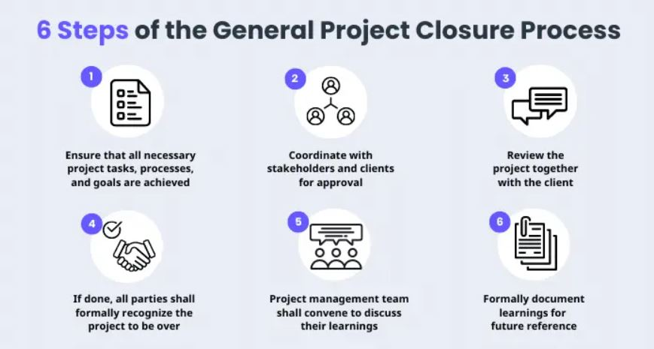
Project closure in Project Management

Slide 41
Different kinds of Project Closures
Project closure is a crucial phase in project management where the project is formally completed and delivered to the stakeholders. There are different kinds of project closures, each serving specific purposes and contexts. Here are the main types of project closures:
1)Normal Closure:
Definition: This is the standard closure process where the project completes its objectives within the planned scope, time, and budget.
Key Activities: Finalizing all project deliverables, conducting project reviews, obtaining final acceptance from stakeholders, closing contracts with vendors, archiving project documentation, and releasing project resources.
2)Premature Closure:
Definition: Occurs when a project is terminated before achieving its planned objectives. This could be due to various reasons such as changes in business priorities, lack of funding, or technical issues.
Key Activities: Assessing the reasons for premature closure, documenting lessons learned, ensuring legal and financial closure with vendors and stakeholders, and formalizing project termination procedures.

Slide 42
3)Failed Closure:
Definition: This occurs when a project fails to achieve its objectives, even after completion of all planned activities. Failure could result from scope creep, inadequate planning, unrealistic expectations, or external factors.
Key Activities: Conducting a thorough post-mortem analysis to understand the causes of failure, documenting lessons learned, identifying corrective actions for future projects, and communicating the failure to stakeholders and sponsors.
4)Administrative Closure:
Definition: Involves the administrative tasks necessary to formally close the project. This closure type is common in large organizations with formal project management processes.
Key Activities: Archiving project documentation, updating organizational process assets, releasing project resources back to the resource pool, and completing administrative closure procedures as per organizational standards.

Slide 43
5)Contractual Closure:
Definition: Specific to projects that involve external vendors or contractors. This closure type focuses on formally ending contracts and agreements related to the project.
Key Activities: Reviewing and closing out contracts with vendors, ensuring all deliverables and payments are completed as per the contract terms, resolving any outstanding issues, and obtaining formal sign-offs from vendors and stakeholders.
6)Post-Implementation Closure:
Definition: In projects where the implementation phase is distinct from project closure, this type involves finalizing activities after implementation to ensure smooth transition and operational readiness.
Key Activities: Conducting post-implementation reviews, addressing post-implementation issues or defects, ensuring handover to operational teams or maintenance, and verifying stakeholder satisfaction with the implemented solution.

Slide 44
Closure Analysis Report
A Closure Analysis Report in software engineering is a comprehensive document that summarizes the outcomes, lessons learned, and recommendations derived from the closure phase of a software project. It serves as a critical tool for organizational learning and improving future project execution. Here’s a detailed outline of what a Closure Analysis Report typically includes:
1. Executive Summary
Brief overview of the project closure process.
Summary of key findings and recommendations.
2. Project Overview
Background of the project including objectives, scope, stakeholders, and timeline.
Summary of major milestones and deliverables achieved.
3. Closure Process
Description of how the closure process was conducted.
Roles and responsibilities of team members involved in closure activities.

Slide 45
4)Achievements and Outcomes
Summary of project achievements against initial objectives.
Metrics or KPIs used to measure success (e.g., project completion rate, adherence to schedule, budget variance).
5. Lessons Learned
Identification of successes, challenges, and failures encountered during the project.
Analysis of root causes for any deviations from the plan.
Lessons learned related to project management, technical aspects, and stakeholder management.
6. Recommendations
Actionable recommendations for improving future project planning, execution, and closure processes.
Suggestions for enhancing team collaboration, communication, and resource allocation.
Proposals for adopting new tools, methodologies, or best practices based on lessons learned.

Slide 46
7)Closure Documentation
Overview of all project documentation and artifacts archived during closure.
Explanation of how documentation will be stored and accessed for future reference.
8.)Feedback and Stakeholder Satisfaction
Summary of stakeholder feedback on the project outcomes.
Analysis of stakeholder satisfaction with the delivered software product or service.
9)Conclusion
Summary of the overall success of the project.
Final thoughts on the significance of the project’s outcomes for the organization.
10) Appendices
Additional supporting information such as detailed project schedules, budget reports, risk registers, and stakeholder communication logs.

Slide 47
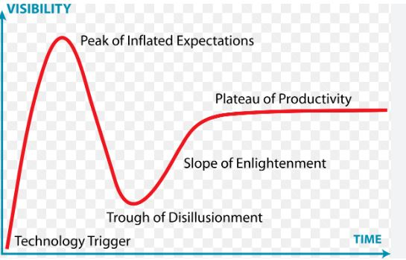
Gartner Hype Cycle
The Gartner Hype Cycle is a graphical representation and methodology developed by the research and advisory firm Gartner to track the maturity, adoption, and social application of specific technologies within various domains. It provides insights into how technologies will evolve over time, from their inception to widespread adoption or eventual obsolescence.

Slide 48
5 Phases of the Gartner Hype Cycle
Phase 1: Technology Trigger
This is the stage when technology is first introduced to the public. It can come from emerging markets, research labs, think tanks and universities. There is usually a lot of hype about the product and its potential applications.
There might be prototypes, but there are often no functional products or market studies. The potential spurs media interest and sometimes proof-of-concept demonstrations.
Phase 2: Peak of Inflated Expectations
At this point, media outlets and industry analysts have picked up on the new technology and its potential applications. This leads to an increase in enthusiasm for it and often unrealistic expectations of what it will do.
Phase 3: Trough of Disillusionment
As reality sets in, it becomes apparent that the initial enthusiasm was misplaced when many limitations become clear or issues arise with the technology. This leads to a decrease in enthusiasm as people question its viability and potential applications.

Slide 49
Phase 4: Slope of Enlightenment
At this stage, more realistic expectations emerge about the product's capabilities, limitations and potential use cases. People are becoming more knowledgeable about what it can accomplish, allowing for more effective implementation in different scenarios.
Phase 5: Plateau of Productivity
The final phase is when the product reaches maturity and widespread adoption in the market. At this point, people are familiar with it and have a good understanding of how to use it effectively. This leads to a higher level of productivity as users become more proficient at leveraging its features for their benefit.

Slide 50
Development Models
Development model" refers to a systematic approach or framework used to organize, plan, and execute the process of software creation.
They show the ways to navigate through the complex and demanding process of software building. A project’s quality, timeframes, budget, and ability to meet the stakeholders’ expectations largely depend on the chosen model.
Development models provide the framework used to plan and execute software milestones and delivery cycles throughout the life of an application. While each design and development model has a different emphasis, they all follow the same basic flow of researching the requirements, design, implementation (coding), and verification or testing.

Slide 51
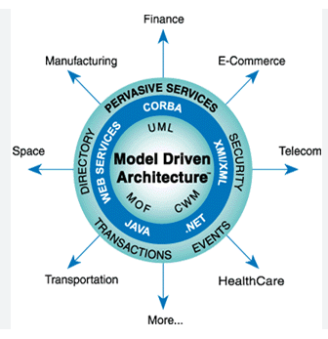
Model-Driven Development
Model-driven development (MDD) is a software development methodology that focuses on creating and exploiting domain models, which are conceptual models of all the topics related to a specific problem. This approach aims to increase productivity, improve quality, and ensure consistency by abstracting complex systems into manageable models.

Slide 52
Key Principles of Model-Driven Development
1)Abstraction:
MDD emphasizes creating high-level abstract models that capture the essential aspects of a system without delving into implementation details. These models serve as a blueprint for the development process, making it easier to understand and communicate system requirements and design.
2)Automation:
A significant goal of MDD is to automate the transformation of models into executable code. Using automated tools, developers can generate a substantial portion of the system from the models, reducing manual coding and minimizing errors.
3)Model Transformation:
MDD involves transforming models at different abstraction levels. These transformations can be from high-level conceptual models to more detailed design models and finally to executable code. Model transformations are governed by rules and mappings defined within the MDD framework.
4)Platform Independence:
By focusing on high-level models, MDD allows developers to create platform-independent designs. These designs can later be transformed into platform-specific implementations, promoting reusability and reducing dependency on specific technologies.

Slide 53
5)Separation of Concerns:
MDD promotes the separation of concerns by dividing the system into distinct models, each representing a specific aspect, such as structure, behavior, or data. This separation makes it easier to manage complexity and allows different stakeholders to focus on different aspects of the system.
6)Traceability:
MDD ensures traceability between different model elements and between models and code. This traceability facilitates impact analysis, debugging, and maintenance by providing a clear mapping from requirements to implementation.
7)Iterative Refinement:
Models are iteratively refined and extended throughout the development process. This iterative approach allows for continuous improvement and adaptation of models to meet changing requirements and ensure alignment with business goals.
8)Validation and Verification:
MDD includes rigorous validation and verification techniques to ensure that models are correct, consistent, and complete. Automated tools can be used to check model syntax and semantics, ensuring high-quality models before code generation.

Slide 54
Benefits of Model-Driven Development
Increased Productivity: Automation of code generation and model transformation reduces manual coding effort and speeds up development.
Improved Quality: Early detection of errors through model validation and verification leads to higher-quality software.
Enhanced Communication: High-level models provide a common language for stakeholders, facilitating better communication and understanding.
Consistency and Reusability: Models ensure consistency across the system and promote reusability of components and designs.
Flexibility and Adaptability: Platform-independent models allow for easy adaptation to new technologies and changing requirements

Slide 55
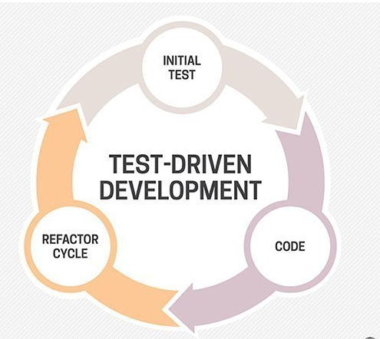
Test Driven Development
Test-Driven Development (TDD) is a software development approach where tests are written before the actual code. This methodology helps ensure that the code works as expected and meets the requirements from the start. Here are the steps involved in TDDTest-Driven Development (TDD) is a software development approach where tests are written before the actual code. This methodology helps ensure that the code works as expected and meets the requirements from the start.

Slide 56
Here are the steps involved in TDD:
Write a Test:
Begin by writing a test for the new functionality you want to implement. This test should be based on the requirements and specifications of the feature.
The test will likely fail initially because the feature hasn't been implemented yet. This step helps to define the desired behavior of the code.
Run the Test:
Execute the test you wrote. Since the functionality is not yet implemented, the test should fail. This failure confirms that the test is functioning correctly and that the feature needs to be developed.
Write the Code:
Write the minimum amount of code necessary to make the test pass. Focus on getting the test to pass, not on writing perfect or complete code. This often involves writing just enough code to fulfill the requirements specified by the test.

Slide 57
Run All Tests:
Run all existing tests, including the new one. The new test should pass, indicating that the new functionality works as intended. Other tests should also pass, ensuring that the new code hasn't broken any existing functionality.
Refactor the Code:
Refactor the code to improve its structure, readability, and efficiency without changing its behavior. This step ensures that the codebase remains clean and maintainable.
After refactoring, run all tests again to ensure that the changes haven’t introduced any new issues.
Repeat:
Repeat the cycle for each new piece of functionality. Each iteration should be small and manageable, ensuring continuous integration and testing throughout the development process.

Slide 58
Advantages of TDD
Early Bug Detection: Writing tests before coding helps catch defects early.
Better Design: Forces developers to think about the design and requirements before implementation.
Documentation: Tests act as documentation for the code.
Refactoring Support: Safe refactoring as tests ensure existing functionality is preserved.
Confidence in Code: Developers can be confident that changes haven't broken existing functionality.

Slide 59
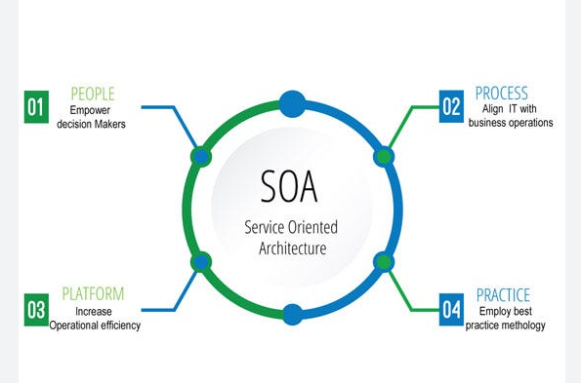
Service-Oriented Development
Service-Oriented Development (SOD) is an approach to software development where applications are composed of independent, loosely-coupled services that communicate over a network. Each service represents a specific business function and can be developed, deployed, and scaled independently.

Slide 60
Key steps involved in Service-Oriented Development
1. Identify Services
Define Business Processes: Understand the business processes and identify the key functions that need to be automated.
Service Boundaries: Determine the boundaries of each service. A service should represent a single, cohesive business function.
2. Design Services
Service Contracts: Define the interface for each service, specifying the inputs, outputs, and communication protocols (e.g., REST, SOAP).
Data Models: Design the data models that services will use. Ensure that data is consistent across services.
3. Develop Services
Implement Service Logic: Write the code to implement the service’s business logic.
Service Granularity: Ensure services are neither too large (monolithic) nor too small (too many micro services), achieving a balance that supports scalability and maintainability.
4. Deploy Services
Service Deployment: Deploy services independently, often in containers or virtual machines to ensure isolation and scalability.
Service Discovery: Implement mechanisms for services to discover each other dynamically, often using a service registry.

Slide 61
5)Manage Services
Service Monitoring: Continuously monitor services to ensure they are performing as expected. Use tools for logging, tracing, and metrics collection.
Service Scaling: Scale services independently based on demand. Use load balancers and auto scaling groups to manage traffic and resource allocation.
6. Ensure Service Interoperability
Standard Protocols: Use standard communication protocols (e.g., HTTP, HTTPS) and data formats (e.g., JSON, XML) to ensure interoperability between services.
API Gateways: Use API gateways to manage and secure service interactions, handle cross-cutting concerns like authentication and rate limiting.
7. Test Services
Unit Testing: Test individual service components to ensure they function correctly.
Integration Testing: Test interactions between services to ensure they work together as expected.
End-to-End Testing: Test the entire workflow to ensure the system meets business requirements.
8. Version and Evolve Services
Versioning: Manage different versions of services to ensure backward compatibility and support incremental updates.
Service Evolution: Continuously update and improve services based on changing business needs and technological advancements.

Slide 62
Aspect-Oriented Development
Aspect-oriented software development (AOSD) is a software design solution that helps address the modularity issues that are not properly resolved by other software approaches, like procedural, structured and object-oriented programming (OOP). AOSD complements, rather than replaces, these other types of software approaches.

Slide 63
Key Concepts of AOSD
Aspect: A module that encapsulates a cross-cutting concern. Aspects are used to define behaviors that cut across multiple classes or methods.
Join Points: Specific points in the execution of a program, such as method calls or field accesses, where an aspect can be applied.
Advice: Code that is executed at a join point. There are different types of advice, including "before," "after," and "around" advice.
Pointcuts: Expressions that define which join points advice should be applied to. Pointcuts allow you to specify where and when aspects should intervene in the program.
Weaving: The process of integrating aspects with the main code base. This can occur at compile time, load time, or runtime.

Slide 64
Use Cases for AOSD
Logging: Automatically logging method calls and execution times without cluttering business logic.
Security: Enforcing security policies across different modules of an application.
Transaction Management: Managing transactions in a declarative way, applying transaction handling uniformly across the business logic.
Examples of AOSD Frameworks
AspectJ: A seamless aspect-oriented extension to the Java programming language, which provides additional syntax and semantics for defining aspects.
Spring AOP: Part of the Spring Framework, this provides aspect-oriented programming support and integrates well with other Spring components

Slide 65
Benefits of AOSD
Improved Modularity: By separating cross-cutting concerns, AOSD promotes cleaner and more modular code.
Enhanced Maintainability: Changes to cross-cutting concerns need to be made in only one place, reducing the risk of errors and making the codebase easier to maintain.
Reusability: Aspects can be reused across different projects, promoting code reuse.

